Slide 1
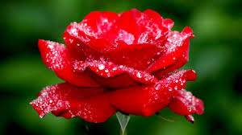
Good morning

Slide 2
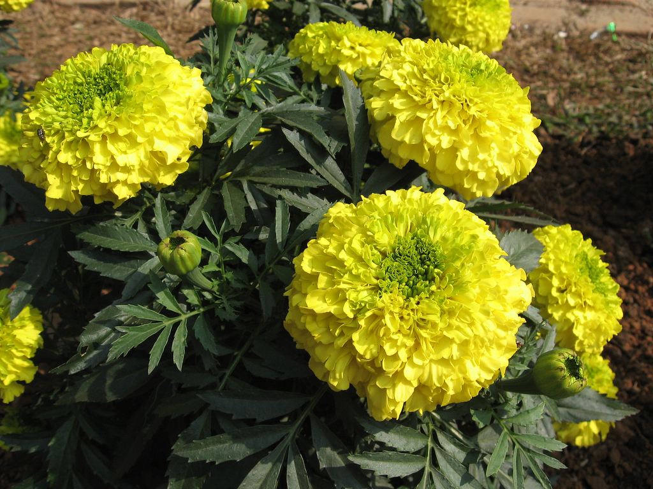
Introducing
Md. Hasim Uddin
Assistant teacher
Kadamshahar High School
Godagari
Rajshahi

Slide 3
Lesson introducing
Class: Nine
Subject: English 1st paper
Unit: 5 lesson: 2
Duration: 50 minutes
Date:

Slide 4
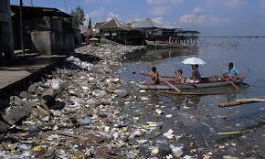
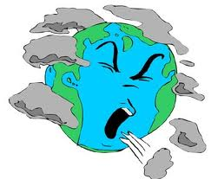
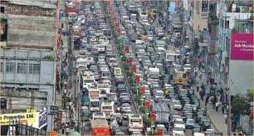
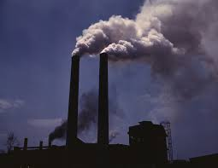
Water pollution
Cough
Air pollution
Sound pollution
ir

Slide 5
Topic
Environment pollution

Slide 6
Learning outcomes
After we have studied this lesson, we will be able to
say about pollution.
mention how to be polluted environment.
Make the solution of environment pollution.

Slide 7
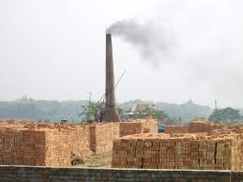
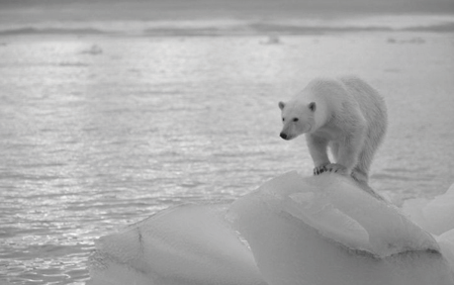
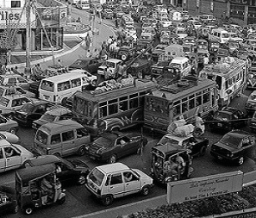
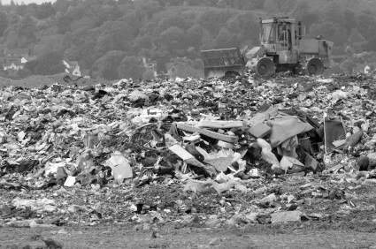

Slide 8
Vocabulary
apparently
Indiscriminate
Significant
Exhaust
Kiln
Lubricant
Encourage
Hazardous
Sediment
Seemingly, clearly
Random, un-planed
Remarkable, important
Weaken, knock out
Burning place of bricks
Oil. Fuel
Motivate, inspire
Risky, dangerous
Silt, grounds

Slide 9
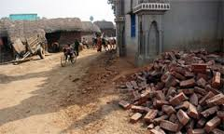
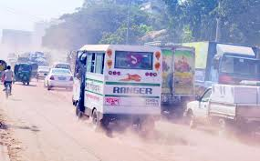
Reading
Air pollution comes from a wide variety of sources, in Bangladesh poisonous exhaust from industrial plants, brick kilns, old and poorly-vehicles and dust from roads and constructions sites are some of the majors sources of air pollution.

Slide 10
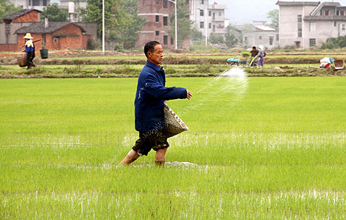
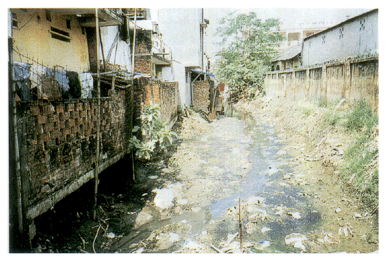
Water pollution
Throwing away toxic substance of the near a water space means it eventually reaches a body of water. Use of pesticides means that when it rains on the lawn or garden, chemicals wash into the water bodies.

Slide 11
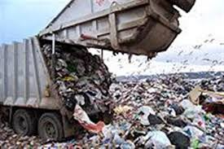
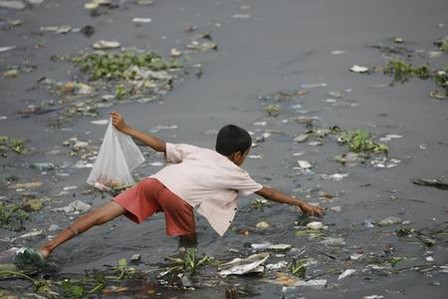
Soil pollution
The mismanagement of household wastes, particularly the polythene shopping bags, has caused serious threat to the soil and the drainage system. Another cause for soil pollution is the use of agricultural pesticides, fertilizers etc.

Slide 12

Individual work
(a)What is air pollution?
(b)What is water pollution?
(c)What is soil pollution?

Slide 13
Answer
(a)when smoke, bad smell, dust mix with air is called air pollution.
(b) when industrial waste, pesticide, dead bodies, open latrine are fallen into water called water pollution.
(C) when polythene bags, pesticides, chemical fertilizers, plastics mix with soil called soil pollution.

Slide 14
Group work
How is water polluted?
How is air polluted ?
How is polluted soil?

Slide 15
answer
Water is polluted with throwing dead bodies of animals and birds, washing livestock, using chemical fertilizers and pesticides on cultivating etc.
Air is polluted with smoke of kiln, industries and vehicles bad smell of dead bodies, constructions dust etc.
Soil is polluted with throwing polythene bags, using chemical fertilizers and pesticides for cultivating, plastic etc.

Slide 16
Home work
Write an article what problem we feel by environment pollution in own your language.

Slide 17
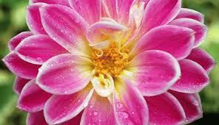
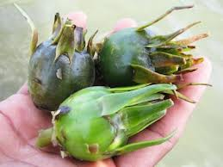
Thank you

